Slide 1


Safety Cheers
2024 Hackathon

Slide 2
Safety Pledge
Safety is our highest priority
Every life is precious
Every accident is avoidable
We uphold safe practices and strive for zero accident

Slide 3

Every accident is avoidable

Slide 4
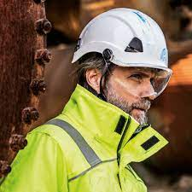
Problem Statement
If safety helmet is worn by worker?

Slide 5




Challenges
Object Detection
Object Relation Detection

Slide 6
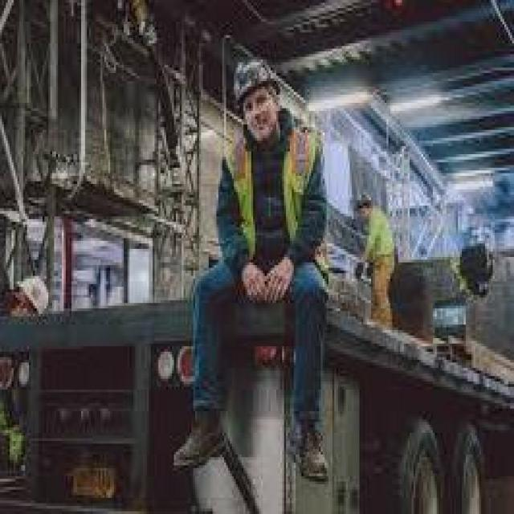
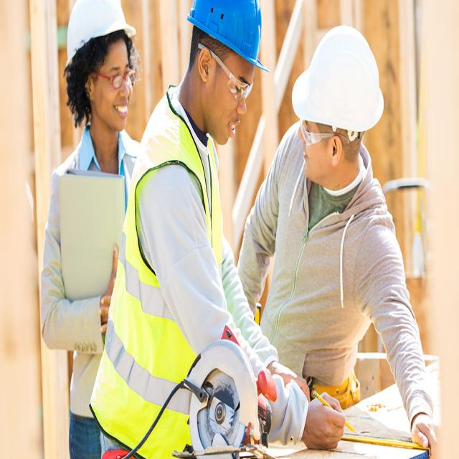
Challenges
Person in helmet
helmet
Low Quality Manually Labeled Data
Relation Labeled Data With High Quality

Slide 7
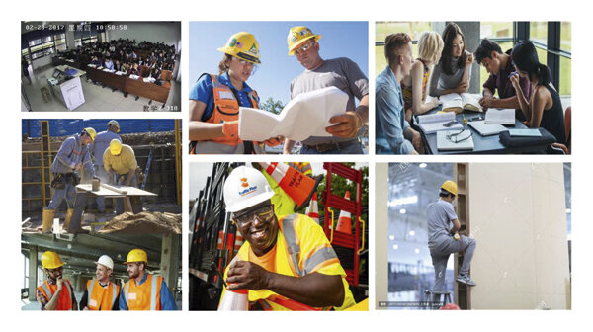



Solution
Labeled Dataset
GroundingDino
Stable Diffusion
Person
Dall-e-3
GPT4V
Prompt Generation
If Person Wear Helmet
Image Generation
Model Training

Slide 8
Solution – Prompt Generation
I have to generate an image dataset for a human wear safety helmet detection model with stable diffusion. Give me 30 different prompts to obtain images of different situations like construction site, High voltage electricity site that helmet correctly worn by workers in different environments and poses. Your response must be only in the form of a python list of strings. Add the string ", photo , 4k, high resolution" at the end of each string
Prompt
Prompts
Prompt Generation
prompts = [ "Construction worker wearing safety helmet at a construction site, photo, 4k, high resolution", … , ".."]

Slide 9
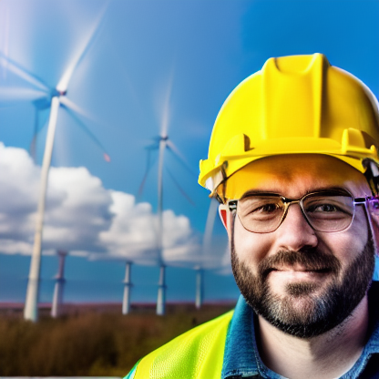
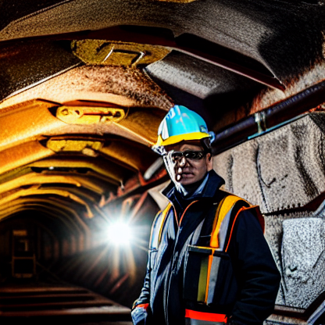
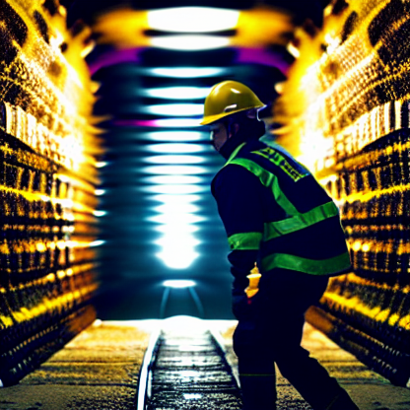
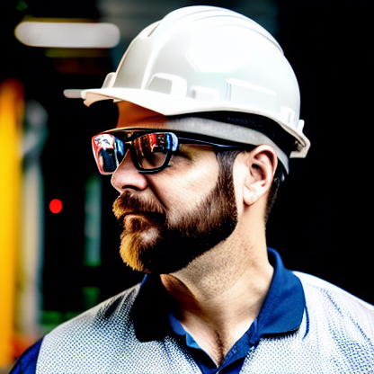
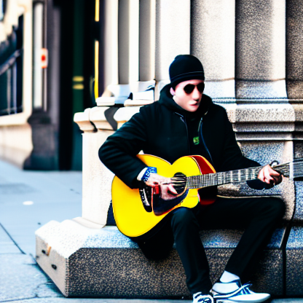
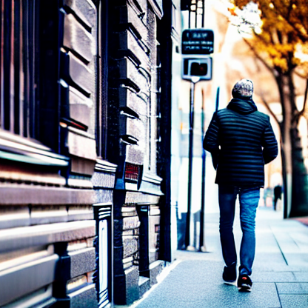
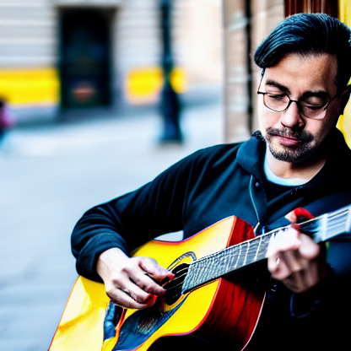
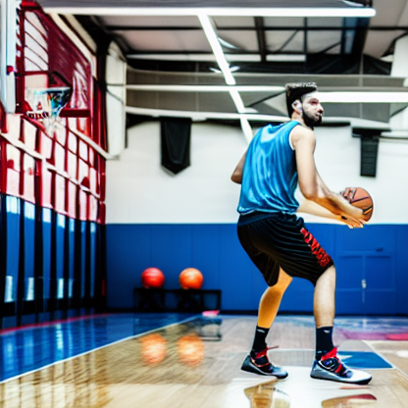
Solution – Image Generation
prompts = [ "Construction worker wearing safety helmet at a construction site, photo, 4k, high resolution", … , ".."]
Prompts
Images
Stable Diffusion
prompts = ["human walking on a busy street, photo, 4k, high resolution", "human studying in a library, photo, 4k, high resolution”,".."]
Dall-e-3
Image Generation

Slide 10
Solution – Image Generation Negative Cases
However, sometimes the model is unable to generate images without helmet. In order to generate more negative case images, use Grounded-SAM to locate and mask the helmet in the image, then use stable diffusion to inpainting the masked area.

Slide 11
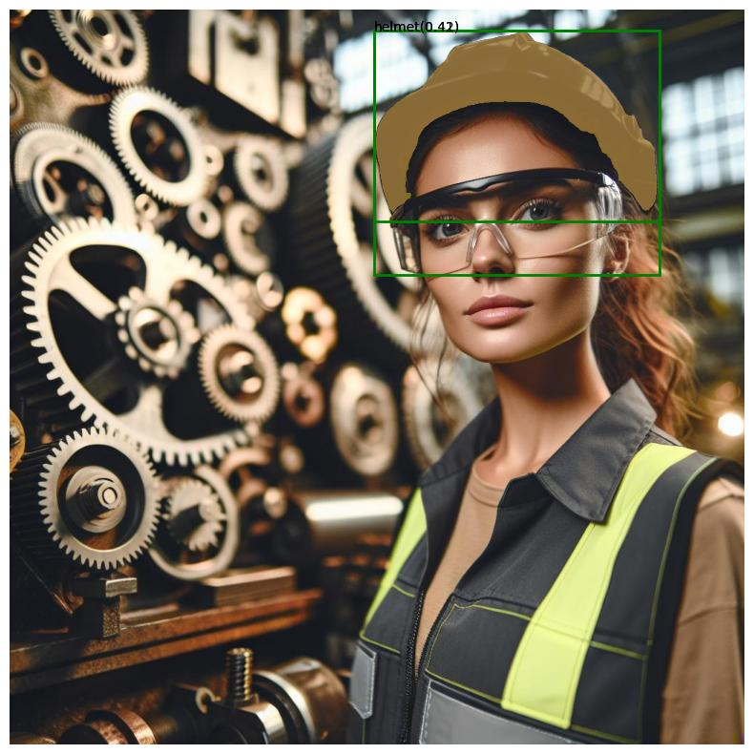
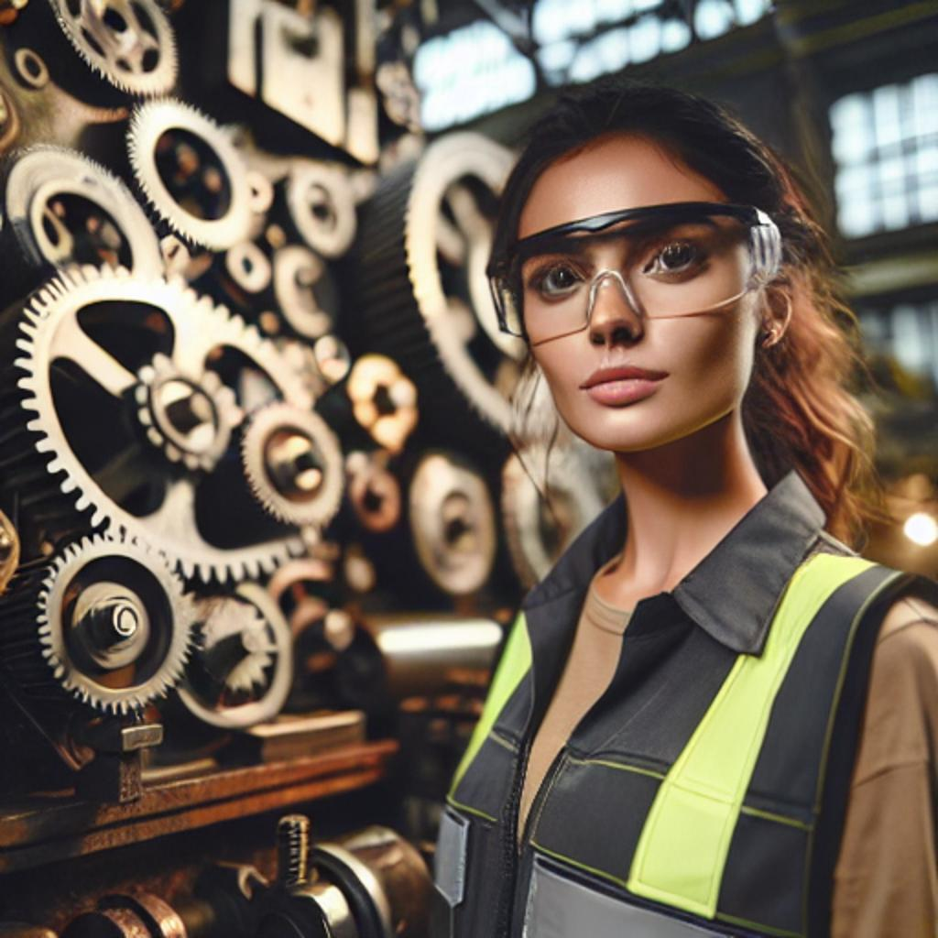
Examples Grounded-SAM + inpainting
Prompt: ’helmet’
Prompt: ‘Human hairs’

Slide 12
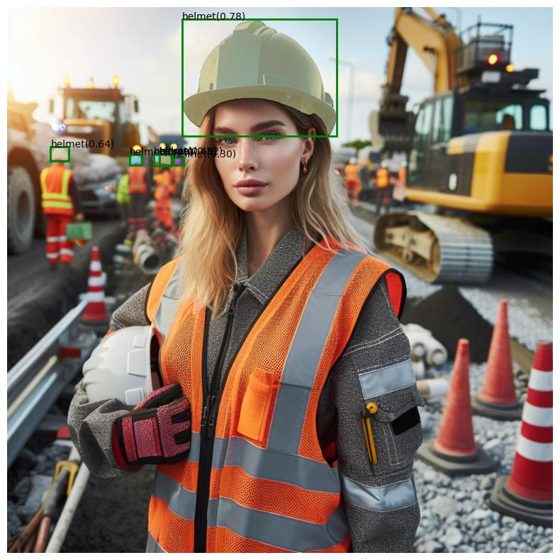
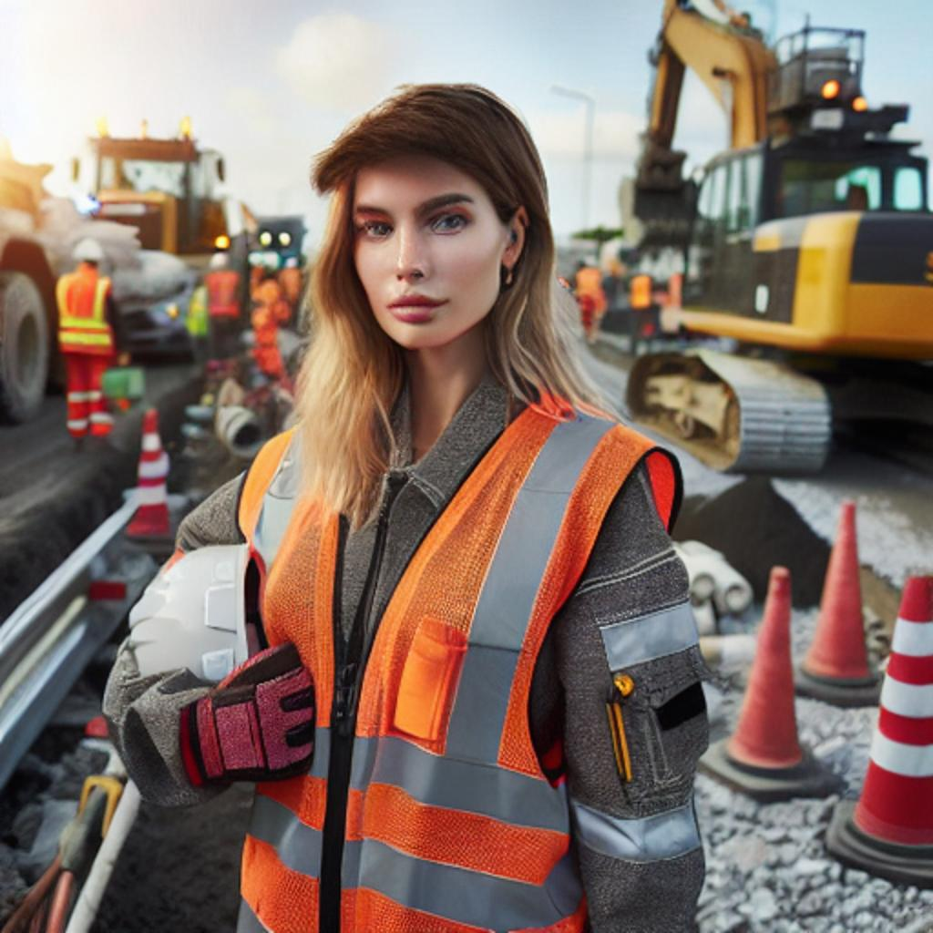
Examples Grounded-SAM + inpainting
Prompt: ‘helmet’
Prompt: ‘human hairs’

Slide 13
Solution – Labeled Image
Labeled Dataset
GroundingDino
Positive
Person
GPT4V
If Person Wear Helmet
Negative

Slide 14
Solution – Model Training
Model Training
data.yaml

Slide 15
Demo

Slide 16
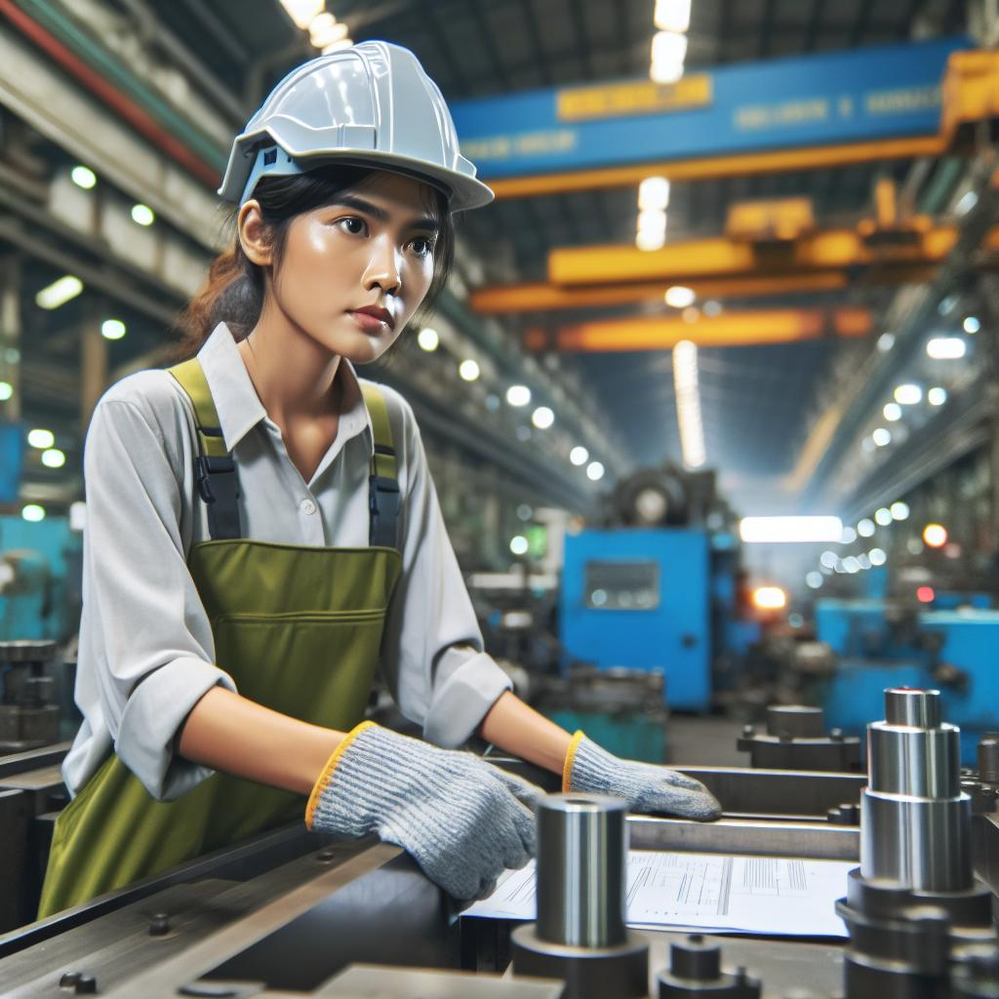
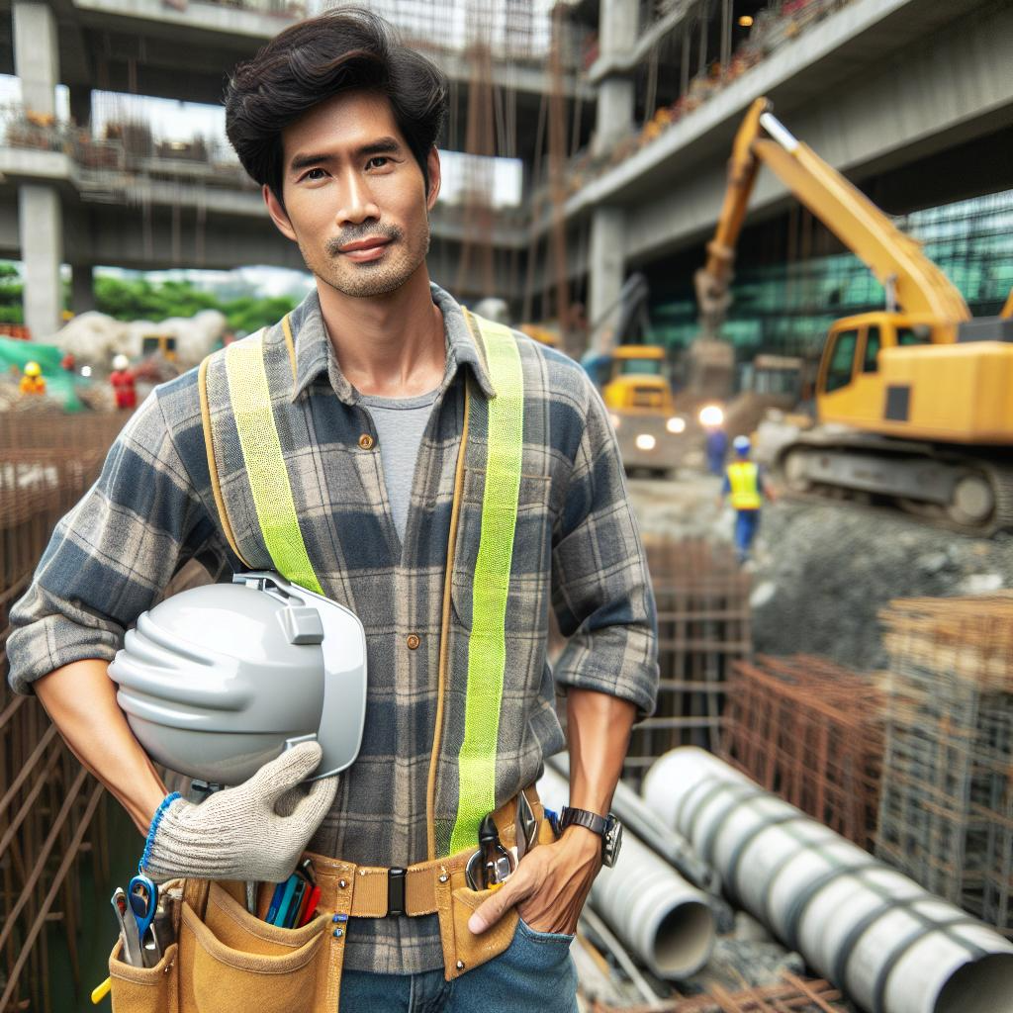
Images generated by Dall-e-3
Positive train image
Negative train image

